Slide 1
机器学习讨论班 RNN, LSTM, Transformer, GAN
2023.12.3

Slide 2

Contents
基于CS231n

Slide 3
Contents
RNN
LSTM
Transformer
GAN

Slide 4
Contents
RNN
LSTM
Transformer
GAN

Slide 5
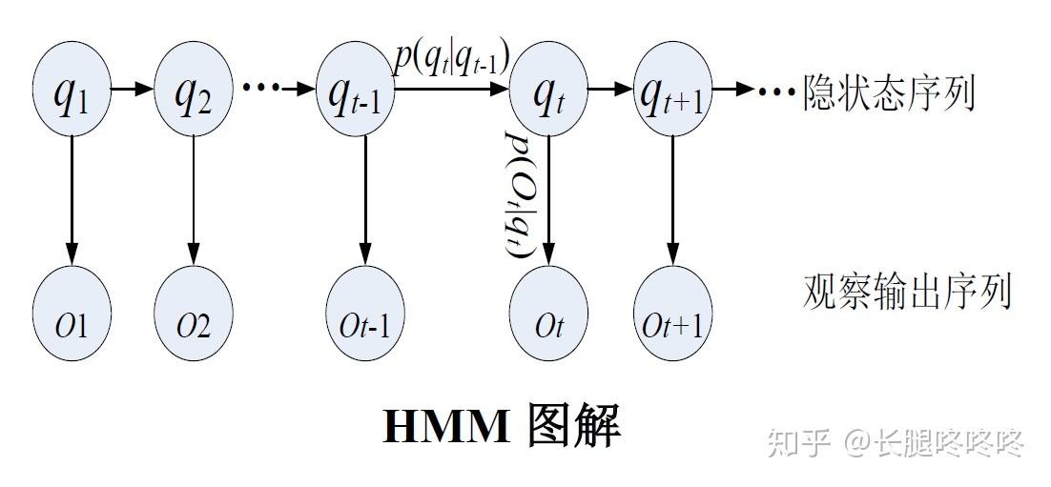
RNN
从HMM（隐马尔可夫模型）开始

Slide 6
RNN
从HMM（隐马尔可夫模型）开始

Slide 7
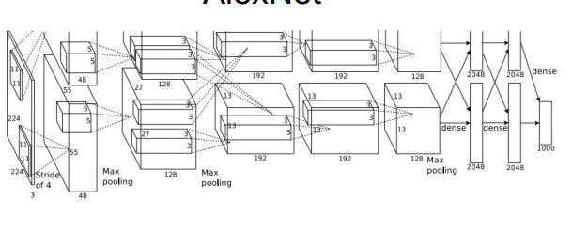
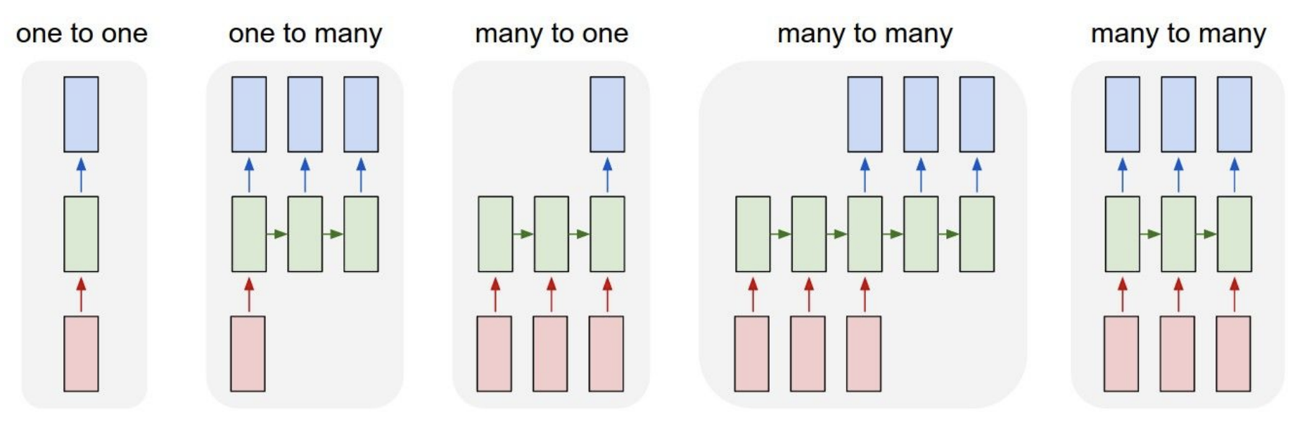
RNN
经典端到端的CNN
假设输入为序列数据？Fixed size input

Slide 8
RNN
不同的网络结构，
对应不同的输入输出

Slide 9
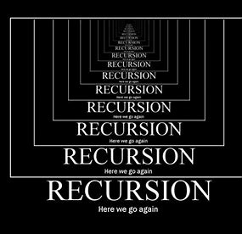
RNN

Slide 10
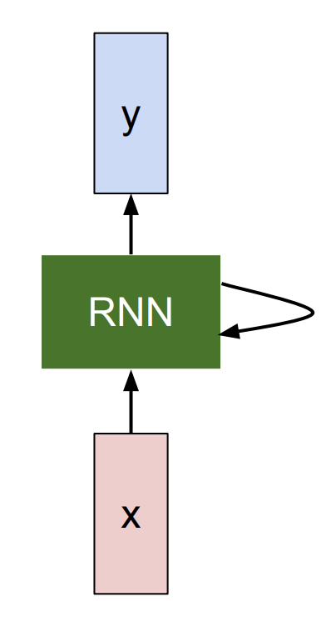
RNN
RNN：
Hidden state

Slide 11
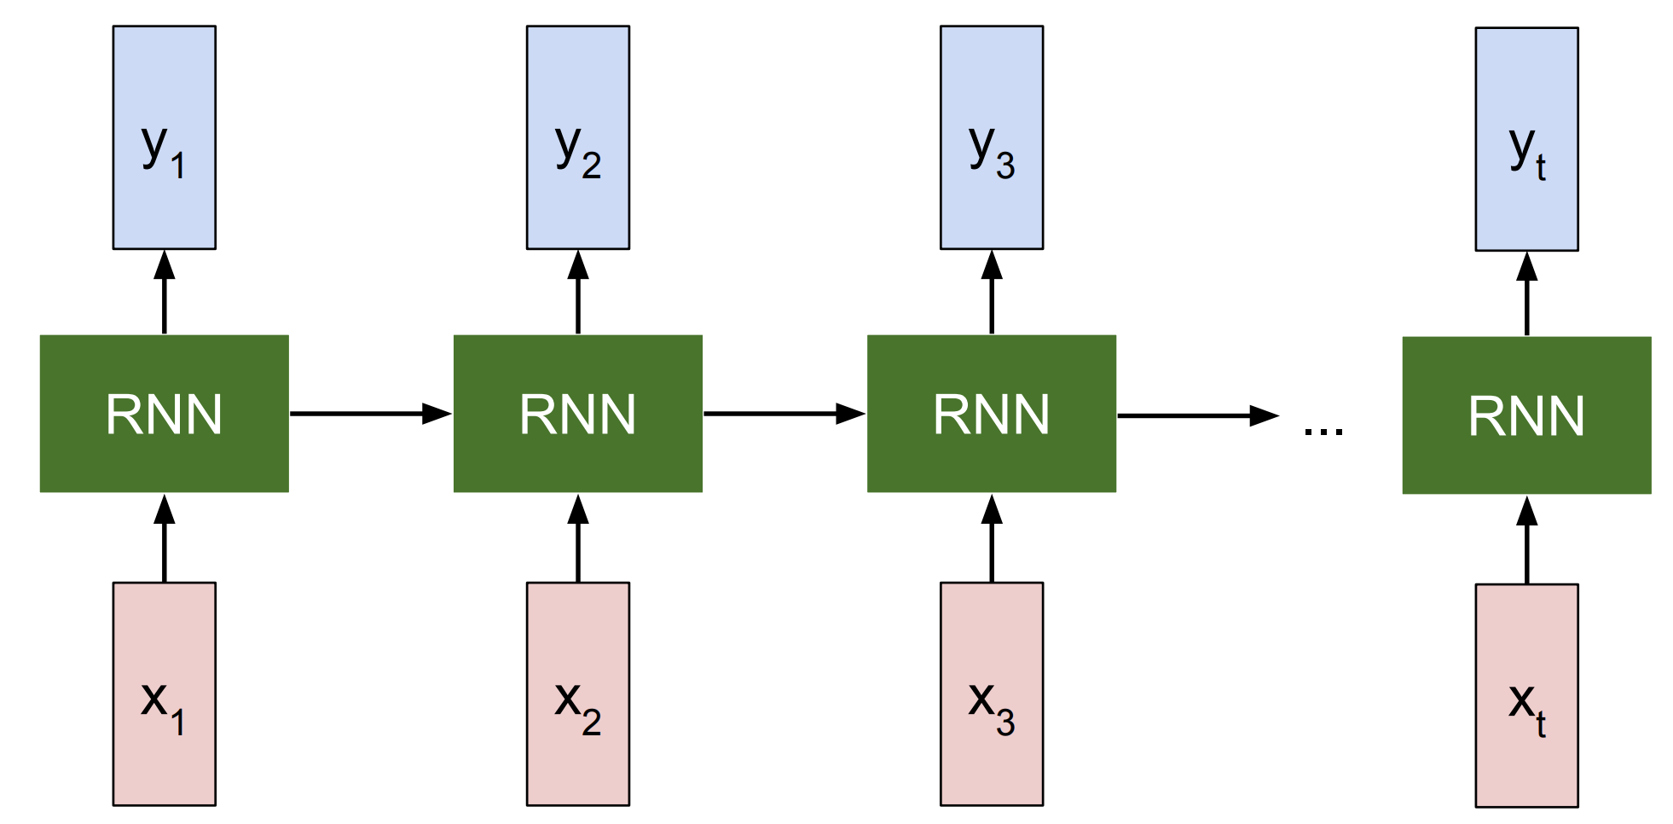
RNN
展开
上一时刻h
输入
x

Slide 12
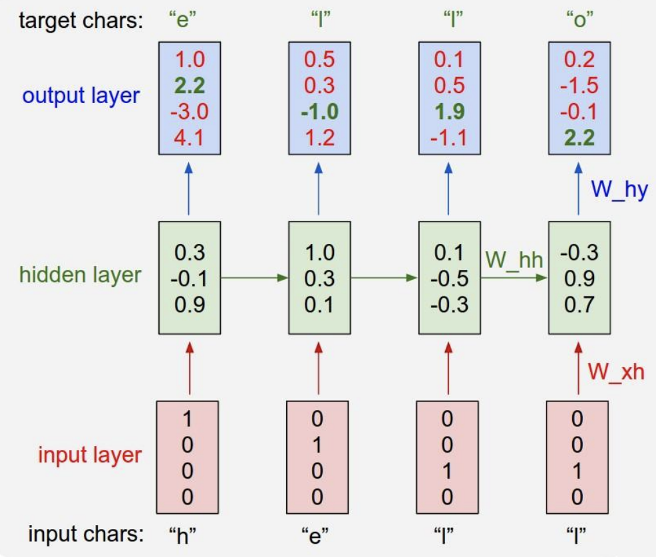
RNN
Vanilla RNN
Hidden
state
共享权值

Slide 13
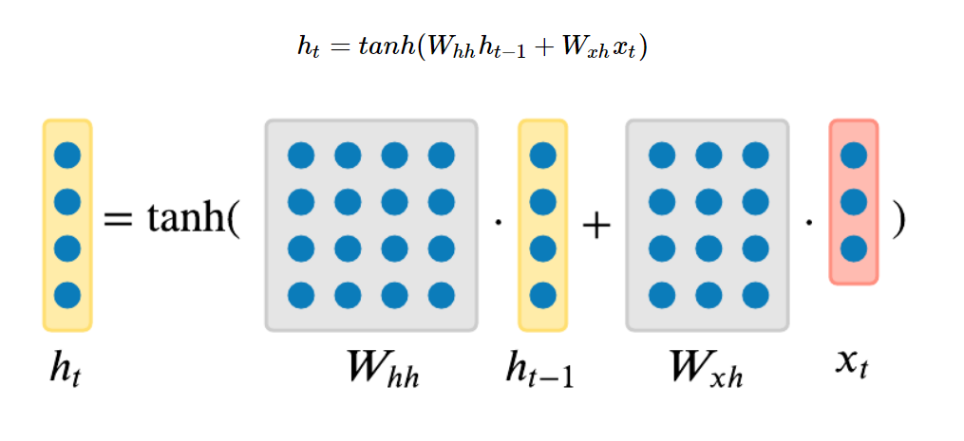
RNN
更新h

Slide 14

RNN

Slide 15
RNN

Slide 16
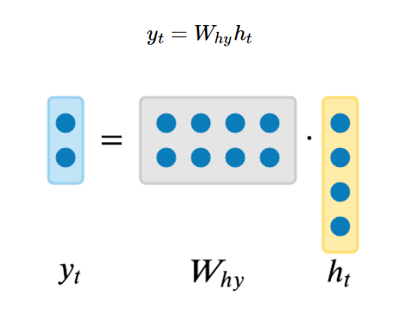
RNN
输出

Slide 17
RNN

Slide 18
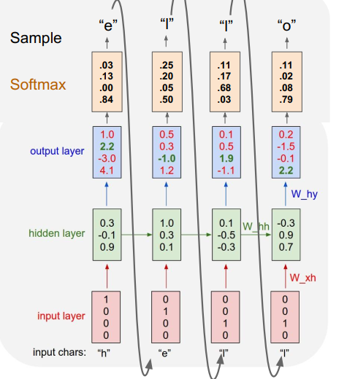
RNN
生成
字符序列
One hot编码

Slide 19
RNN
BP flow
更新参数

Slide 20
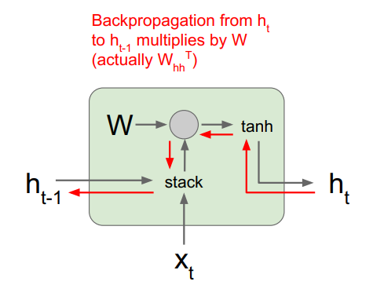
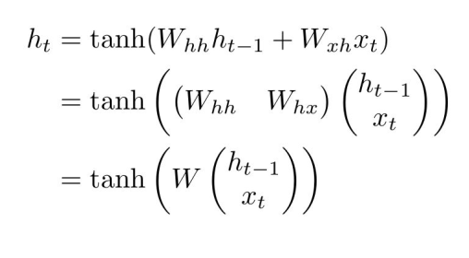
RNN

Slide 21
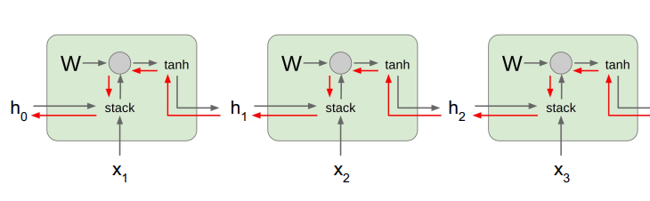
RNN
BP flow

Slide 22
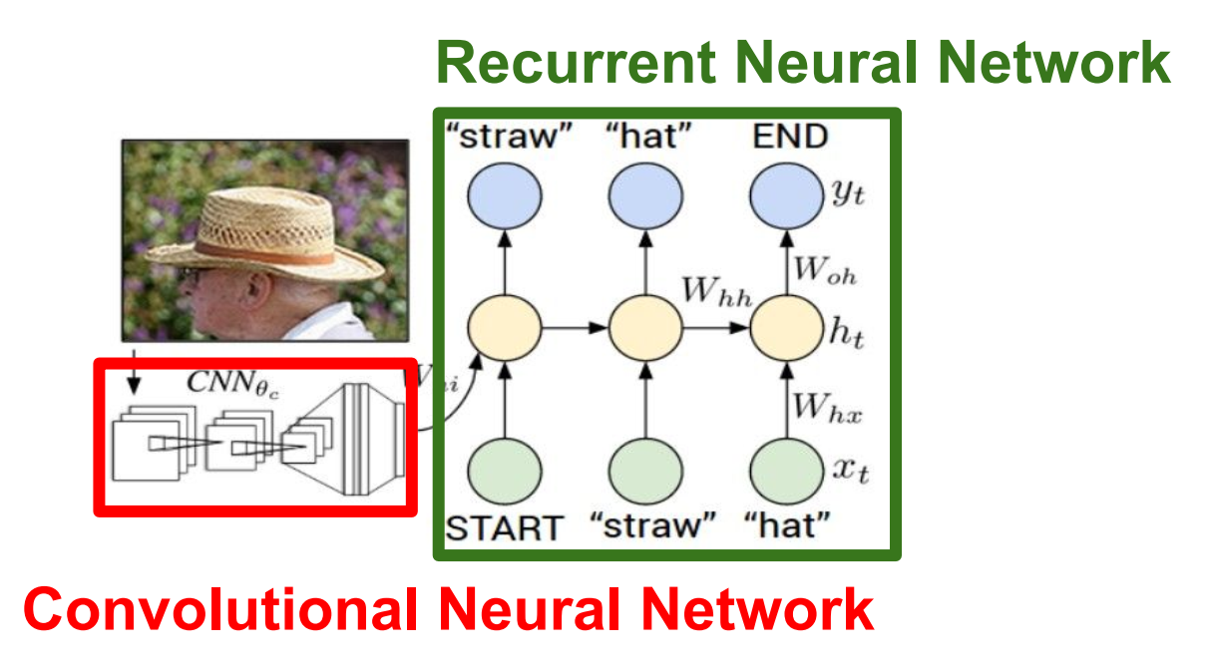
RNN
RNN for Image caption

Slide 23
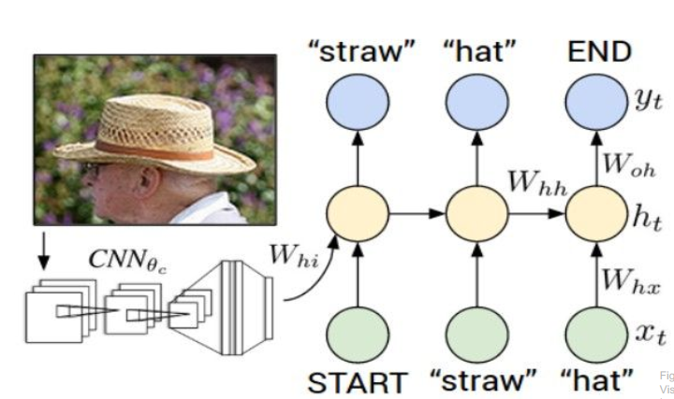
RNN
仿射和softmax输出
RNN for Image caption
CNN 特征和仿射
RNN 前向

Slide 24
RNN
训练
RNN for Image caption

Slide 25
RNN
生成
RNN for Image caption

Slide 26
RNN implementation in CS231n
RNN step forward/backward
RNN forward/backward
RNN image-caption class define
data preparation, model definition, optim definition, training loop, result getting

Slide 27
Contents
RNN
LSTM
Transformer
GAN

Slide 28
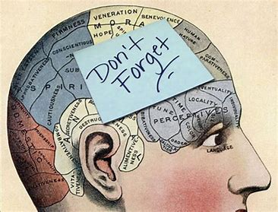
LSTM

Slide 29
LSTM
Long short term
Memory

Slide 30
LSTM
问题：
梯度爆炸/消失

Slide 31
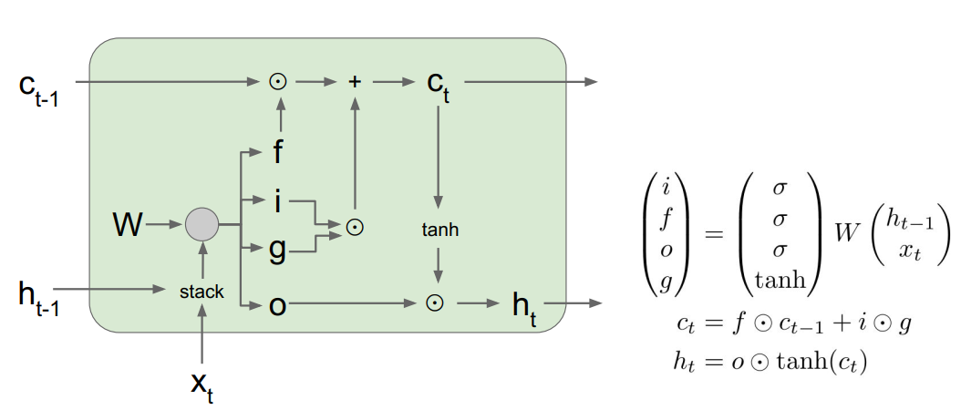
LSTM

Slide 32
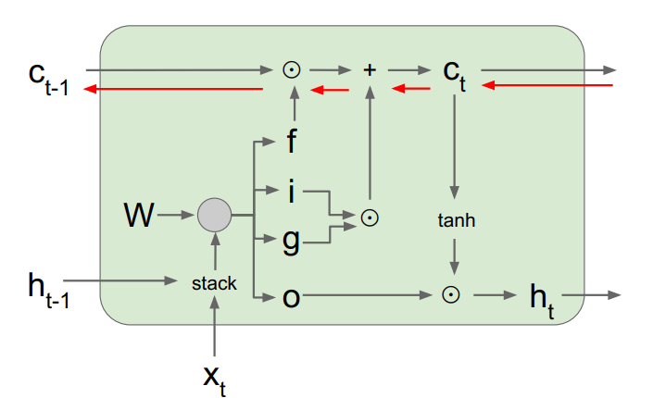
LSTM
BP 快速通道
Notes:
Ml的含义解释

Slide 33
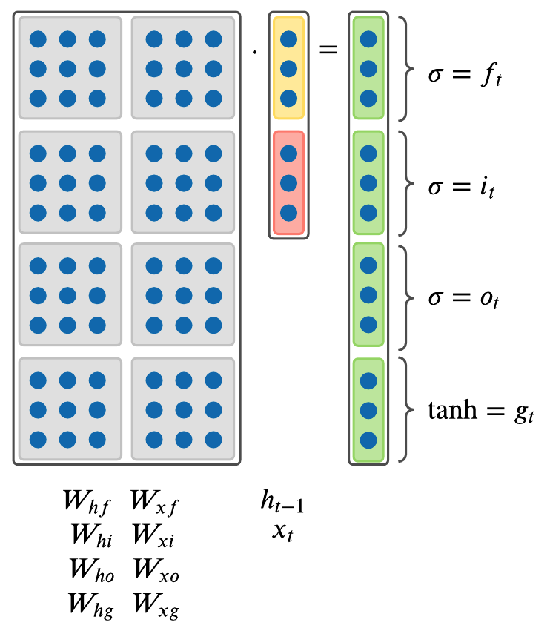
LSTM
Input gate
Forget gate
Output gate
Gate gate
y still output from h
Notes:
Ml的含义解释

Slide 34
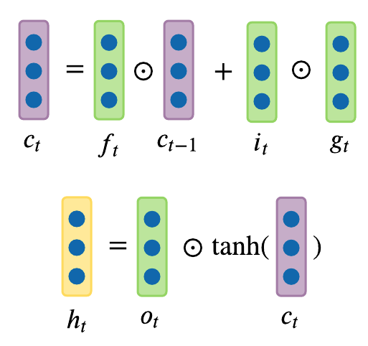
LSTM
Notes:
Ml的含义解释

Slide 35
LSTM implementation in CS231n
LSTM step forward/backward
LSTM forward/backward

Slide 36
Contents
RNN
LSTM
Transformer
GAN

Slide 37
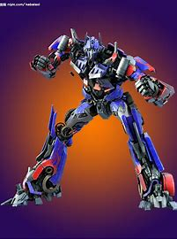

Transformer
Notes:
Ml的含义解释

Slide 38
Transformer
1. RNN是串行的
2. 每一时刻，RNN只关注了前面序列的信息，没有关注全局信息。
3. Ashish Vaswani, et al. “Attention is all you need.” NIPS 2017 -- 完全基于注意力的模型Transformer，没有利用卷积层。
Notes:
Ml的含义解释

Slide 39
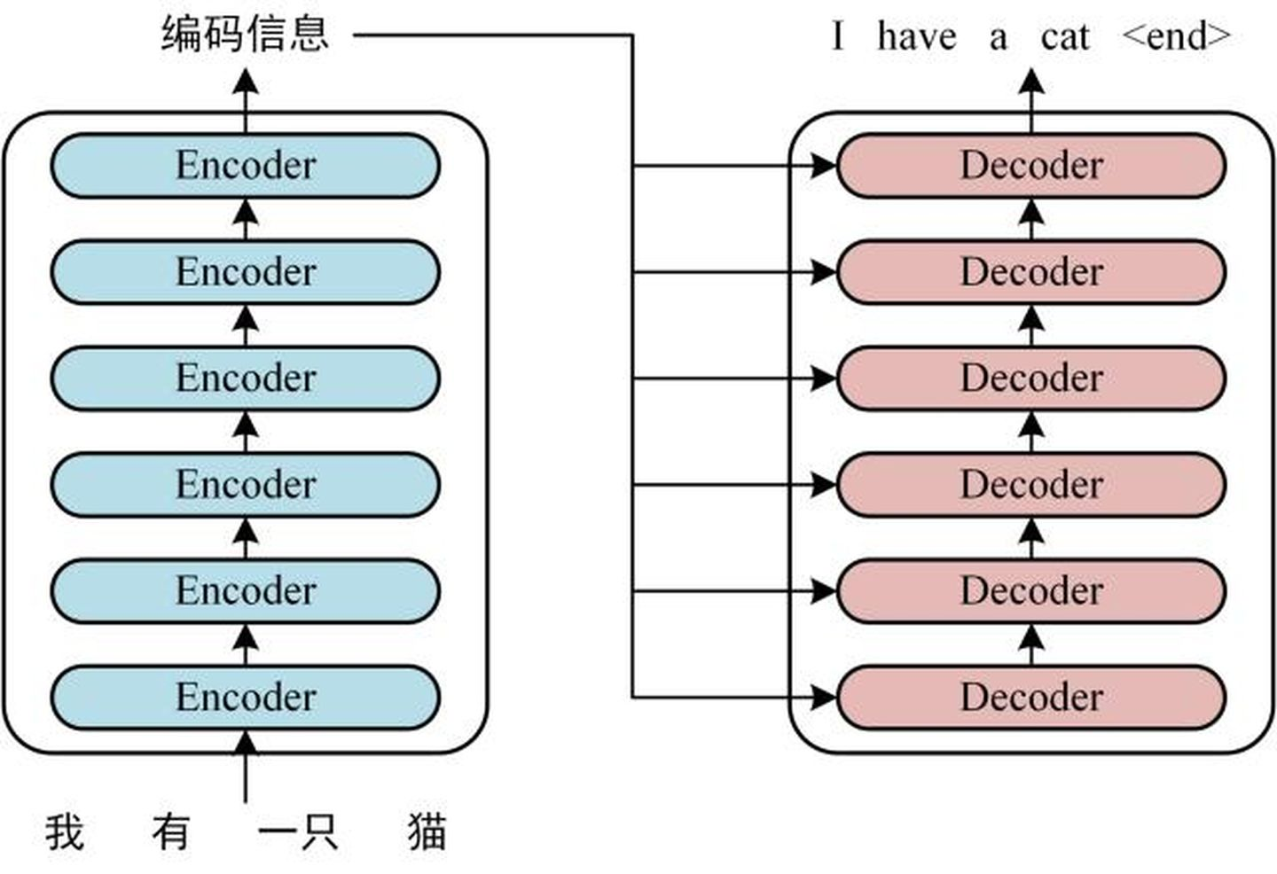
Transformer
Encode-decoder

Slide 40
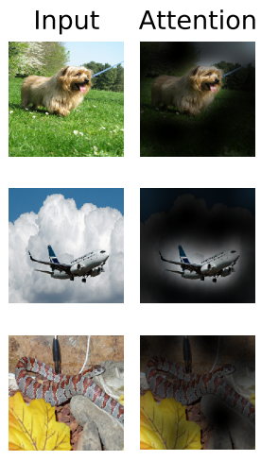
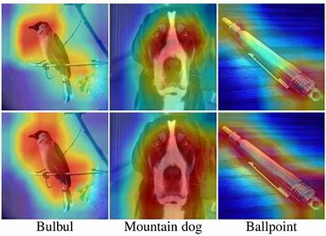
Transformer-attention

Slide 41
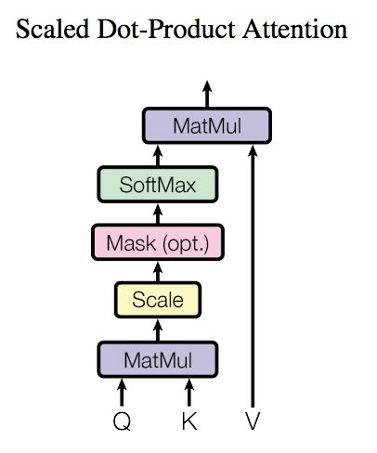
Transformer
注意力机制
Scaled；
Dot-product；
Q-query
K-key
V-value
字典dict in python

Slide 42
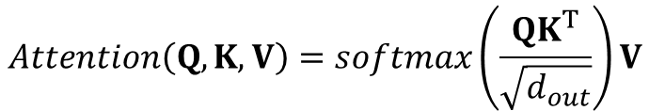
Transformer
注意力机制
Scaled；
Dot-product；
Q-query
K-key
V-value

Slide 43
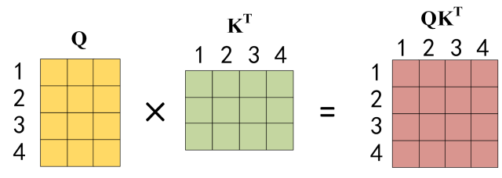
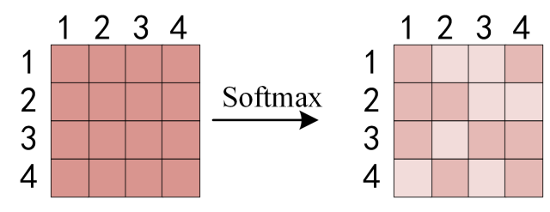
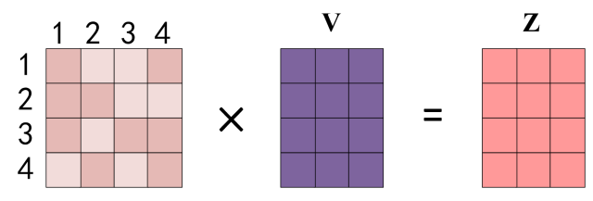
Transformer

Slide 44
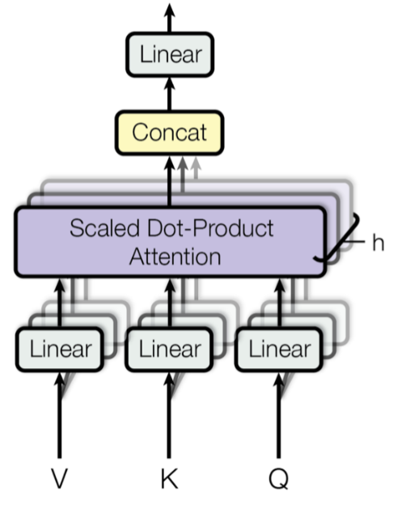
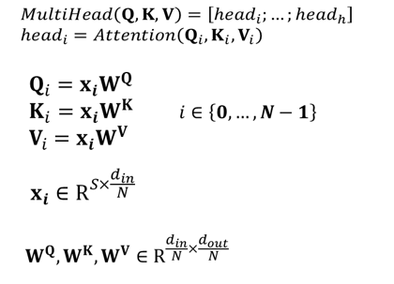



Transformer
多头注意力机制

Slide 45
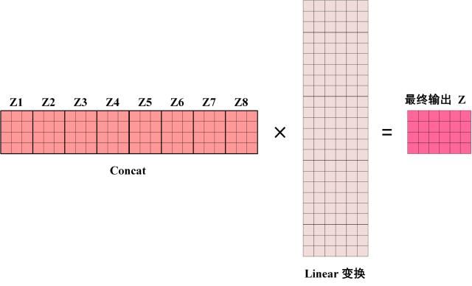
Transformer

Slide 46
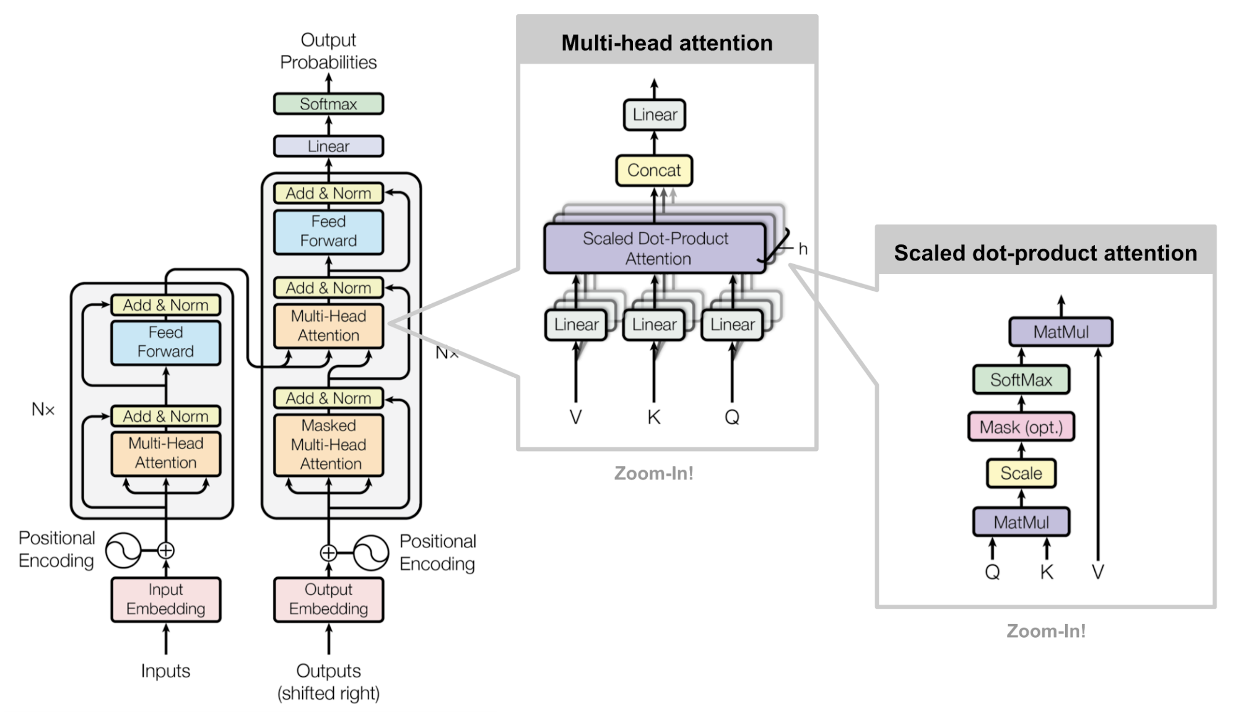
整体架构

Slide 47

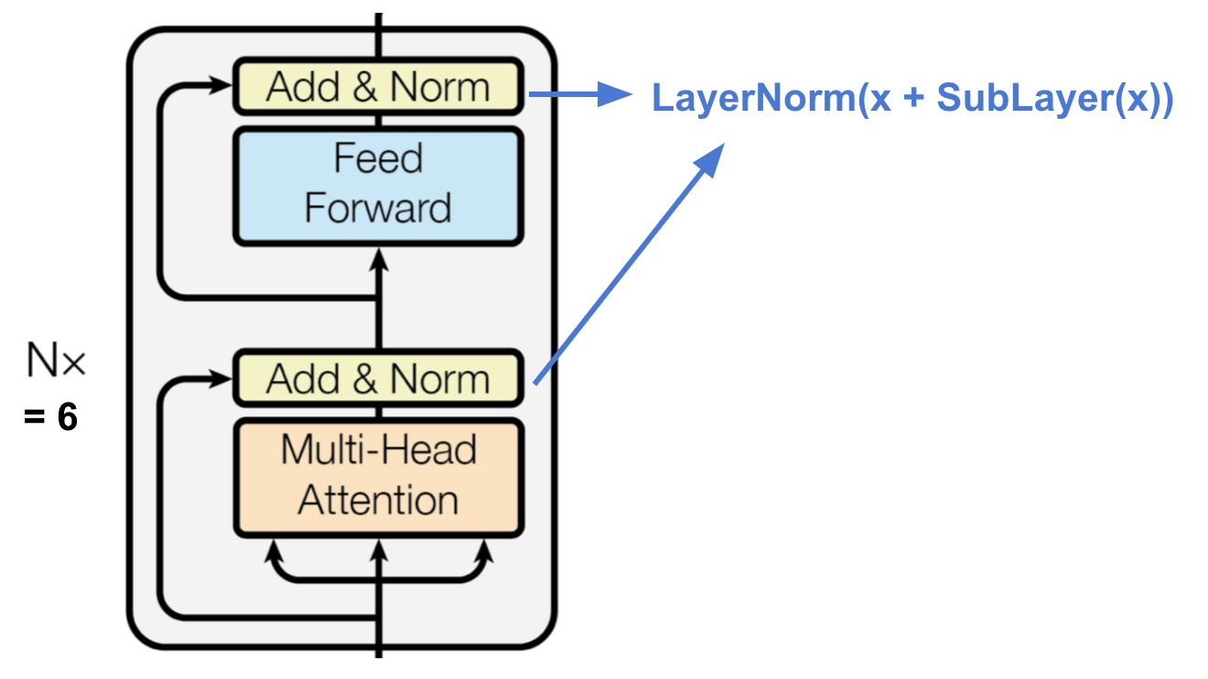


Transformer
编码器
编码器由6个相同的层按顺序相连
残差连接
LayerNorm：对单个样本归一化

Slide 48

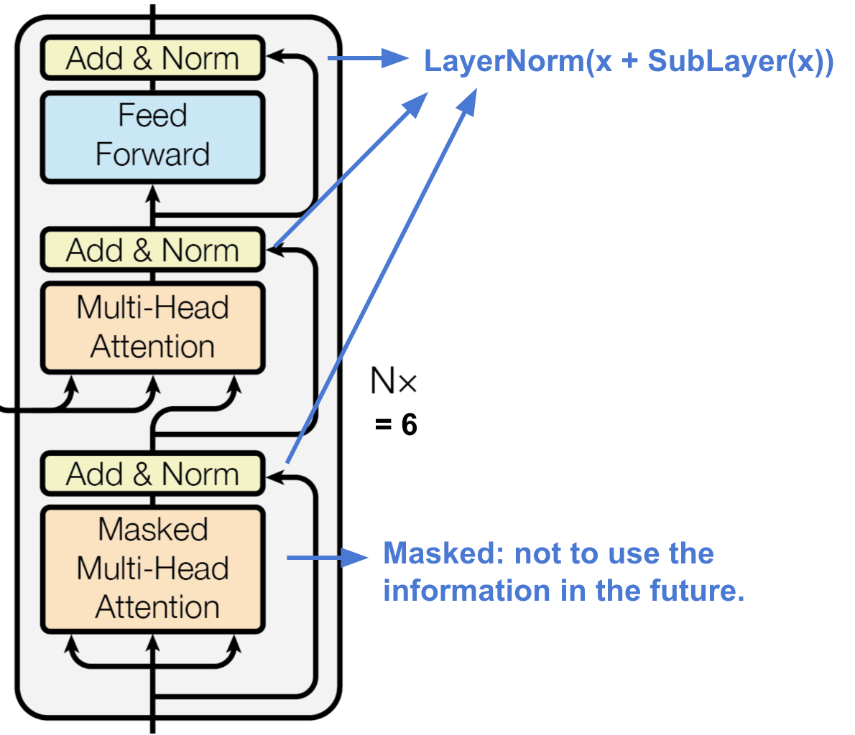


Transformer
解码器
解码器由6个解码层按顺序相接构成
输入的是mask的信息
QKV的不同

Slide 49
整体架构

Slide 50
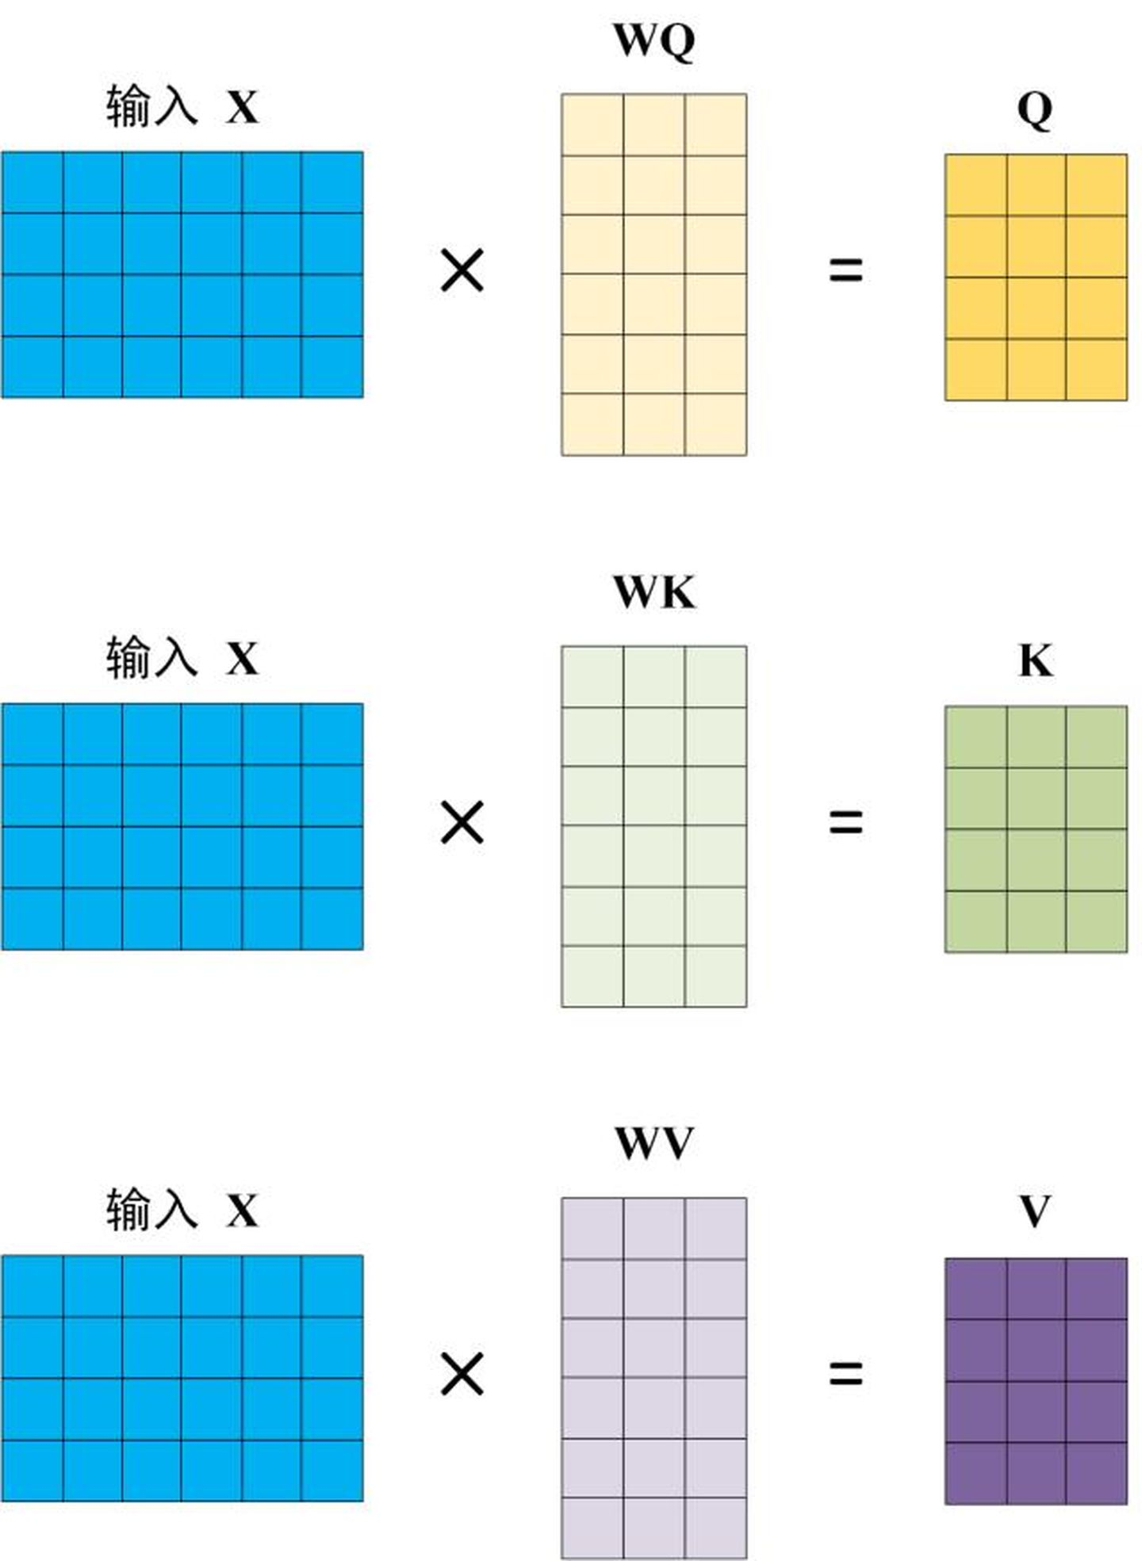
Transformer
输入embedding操作

Slide 51
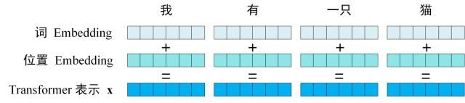
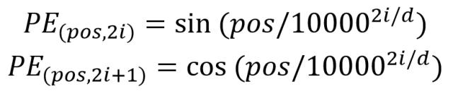
Transformer
给输入x embedding添 加位置信息
更多细节https://kazemnejad.com/blog/transformer_architecture_positional_encoding/

Slide 52
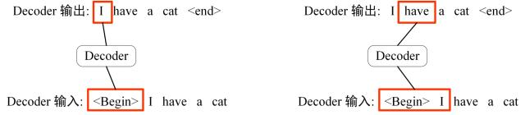
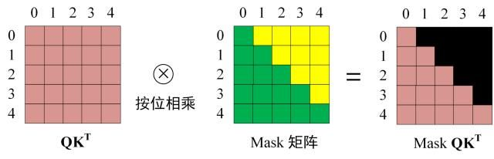
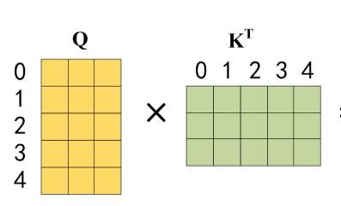
Transformer
Mask机制
masked

Slide 53
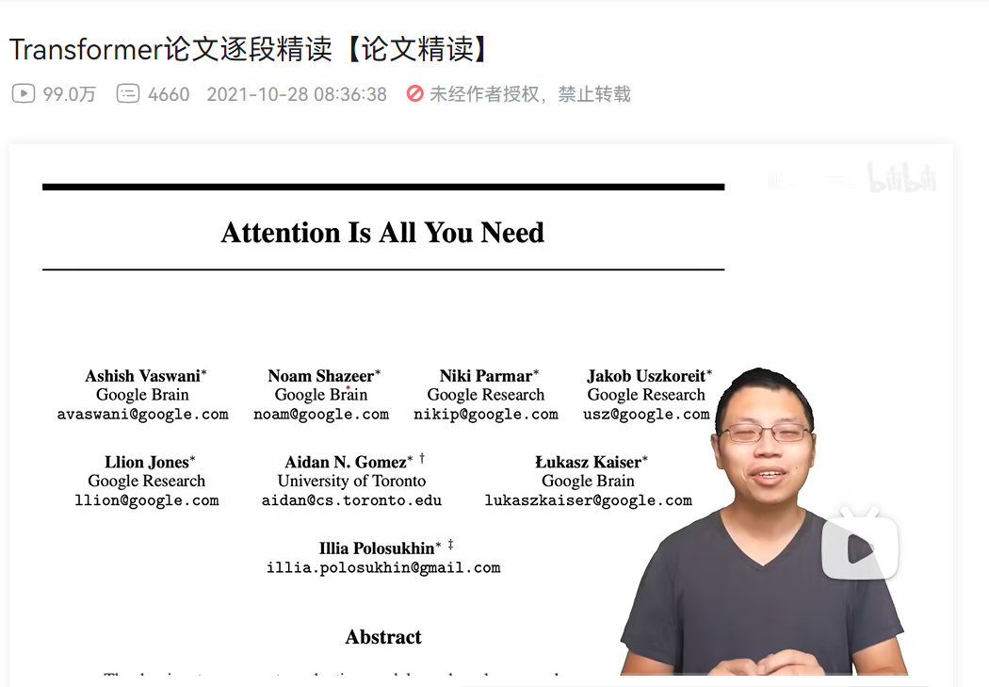
Transformer
李沐老师的
详细解读

Slide 54
Transformer implementation in CS231n
Transformer position embedding
Transformer Multi-head Attention
Transformer training

Slide 55
Contents
RNN
LSTM
Transformer
GAN

Slide 56
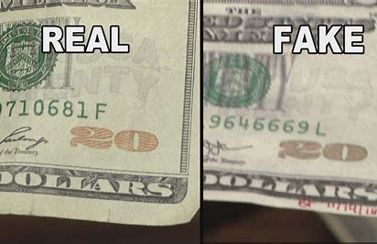
GAN-Generative Adversarial Networks

Slide 57
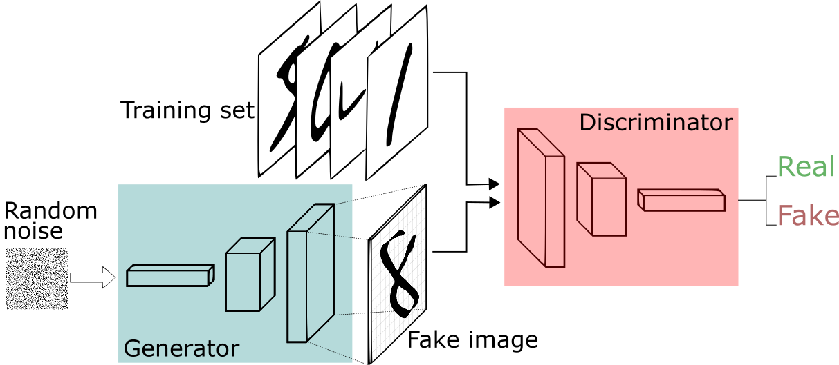
GAN

Slide 58
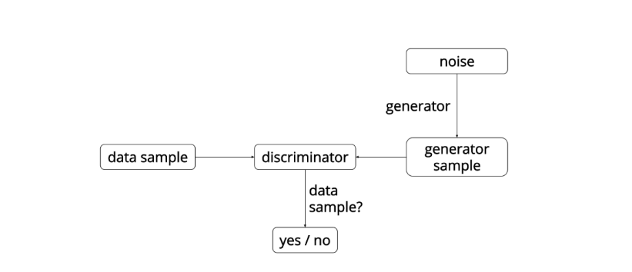
GAN-Generative Adversarial Networks
Generative Adversarial Networks (GANs)

Slide 59
GAN
判别器Discriminator：
A traditional classification network which is trained to classify images as being real (in the training set) or fake (not in the training set)

Slide 60
GAN
生成器Generator：
The generator takes random noise as input and transform it using a neural network to produce images. The goal of the generator is to fool the discriminator into thinking the images it produced are real (in training set).

Slide 61
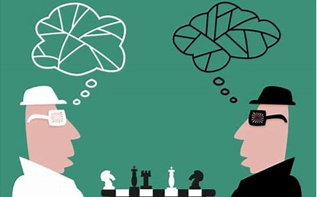
GAN

Slide 62
GAN
GAN loss: fake money
(binary cross-entropy loss)
D-Discriminator
G-Generator
p(z)-random noise
G(z)-generated image of G
D-output from D, being real

Slide 63
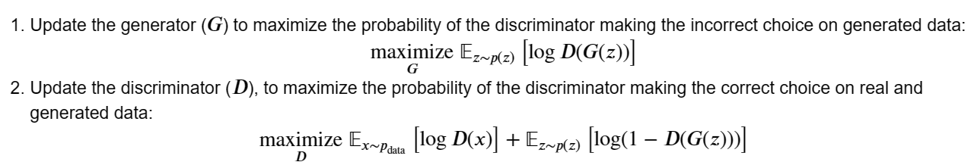
GAN
GAN Optim idea:
① Optim D with true images and G images
② Then optim G using the D’s feedback

Slide 64
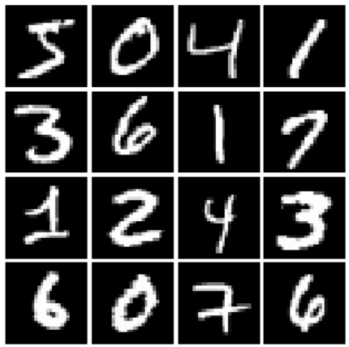
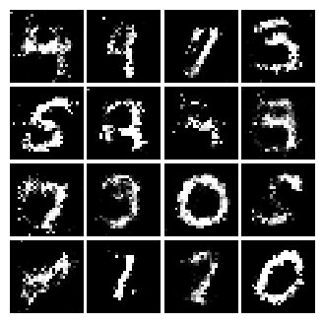
GAN
GAN is generative model, in stead of discriminative model!

Slide 65
GAN implementation in CS231n
GAN G noise
GAN G/D loss
GAN G/D network layers
GAN Optimization/Training
GAN visualization

Slide 66
Contents
推荐

Slide 67
推荐
Courses:
CS229 Machine Learning
CS231n CNN
上海交通大学 张志华 统计机器学习
Notes:
6034很好，兴趣的课，AI导论；李航，李沐很多老师的课；cs229偏数学推导，有线性代数的辅导课。

Slide 68
推荐
Books:
西瓜书-周志华
机器学习方法-李航
CS229 main notes-吴恩达
Deep Learning-花书
Notes:
西瓜书是给会机器学习的人看的。

Slide 69
Thanks!
2023.12.3

